Slide 1





Sephora Skincare Commercial & Customer Analytics
An end-to-end data analytics and decision-support suite evaluating 2,351 SKUs and 1,094,411 customer reviews to isolate quality risk, brand dependency, and assortment pricing elasticity.
$192.54M
1.09M+
40.89%
$6.27M
CATALOG REVENUE PROXY
VERIFIED REVIEWS INGESTED
TOP 10 BRAND REVENUE SHARE
QUALITY RISK ISOLATED

Slide 2


Executive Problem & Scope
Quality & Churn Exposure
Concentration & Pricing Power
Catalog aggregate ratings (4.30★) conceal severe product failure among high-traffic SKUs, threatening customer lifetime value and platform trust:
High supplier dependency and unoptimized price tiers leave gross margin on the table across seasonal assortment cycles:
▪
How concentrated is platform revenue among top supplier anchors?
▪
Which high-volume SKUs exhibit severe customer dissatisfaction?
▪
How much revenue is tied directly to items scoring under 3.50★?
▪
Do Limited Edition drops sustain pricing elasticity without rating loss?
▪
Which out-of-stock items risk automatic procurement re-orders?
▪
Which price tier generates maximum commercial revenue yield?

Slide 3






Data Engineering & Validation Pipeline
1. Ingestion (Python)
2. Modeling (PostgreSQL)
3. Reporting (Power BI)
Extracted and cleaned 1,094,411 partitioned raw review records. Handled missing categorical values, normalized text fields, and transformed datetimes to standard ISO format.
Engineered relational schemas across 2,351 catalog SKUs. Executed 13 core business rules (BR-01 to BR-08) covering pricing elasticity, Pareto curves, and quality thresholds.
Authored DAX measures mirroring backend SQL queries 1:1. Built an interactive 3-page reporting suite with zero reconciliation discrepancies between SQL and front-end visuals.

Slide 4
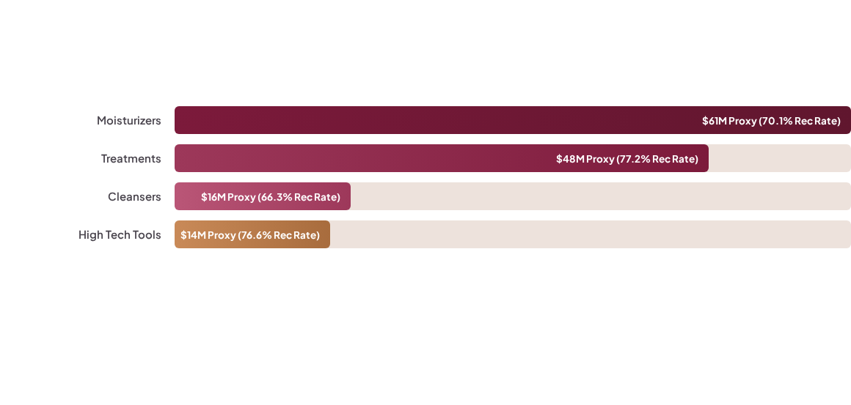
Macro Sub-Category Revenue Engine
Key Diagnosis: Moisturizers and Treatments drive 56%+ of platform sales ($109M), but Cleansers suffers from elevated churn (66.3% advocacy), while High Tech Tools yields high revenue per SKU due to premium unit price realization.

Slide 5


Brand Concentration & Pareto Risk
High Dependency on Anchor Vendors
The top 10 brands generate $78.74M of total platform revenue proxy, creating significant operational and commercial exposure:
40.89%
• Volume vs. Luxury Drivers: La Mer ($13.4M) leads through high average ticket prices ($320+), whereas Drunk Elephant ($11.6M) and Tatcha ($10.1M) scale via mass-market review velocity.
TOP 10 BRAND REVENUE SHARE
• Commercial Decision: Expand incubation partnerships in the $25–$100 tier to build secondary revenue anchors and de-risk single-vendor disruptions.

Slide 6
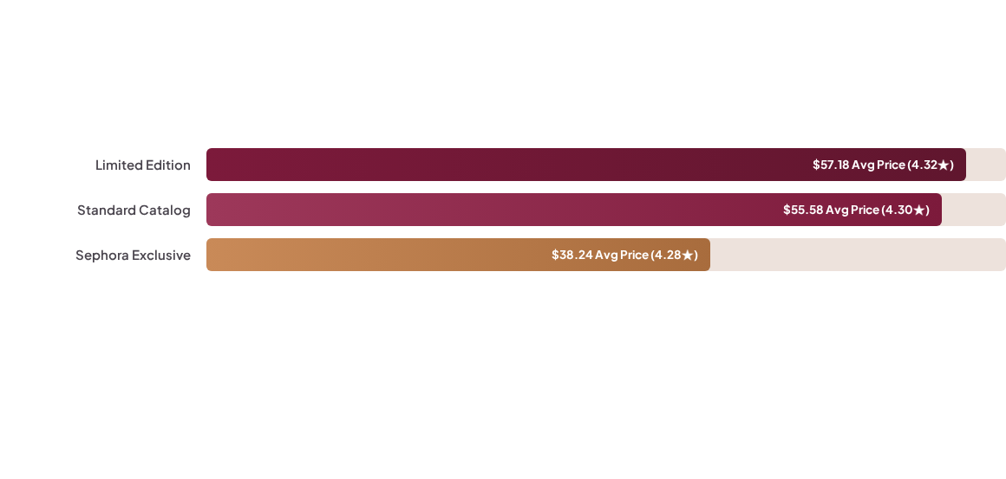
Assortment Pricing Elasticity
Pricing Finding: Limited Edition SKUs command higher prices without sentiment decay, while the $50–$100 Premium Tier generates the largest revenue volume ($78M), validating aggressive expansion of high-margin seasonal drops.

Slide 7


Product Quality & Revenue Risk
44 Attention SKUs Isolated
Immediate Procurement Holds
Applying business rule BR-07 (Rating < 3.50, Reviews > 50) isolates underperforming items that damage category health:
Stockout analysis intersects directly with quality failure, creating a clear operational intervention point:
▪
$6.27M Revenue Proxy Exposed: Direct commercial sales tied to failing formulations.
▪
5 Flagged SKUs Out-of-Stock: Currently out of stock, preventing automatic replenishment.
▪
13.32K Negative Reviews: High customer exposure driving platform churn and product return overhead.
▪
Action Mandate: Enforce mandatory quality & PDP audits prior to issuing new purchase orders.

Slide 8
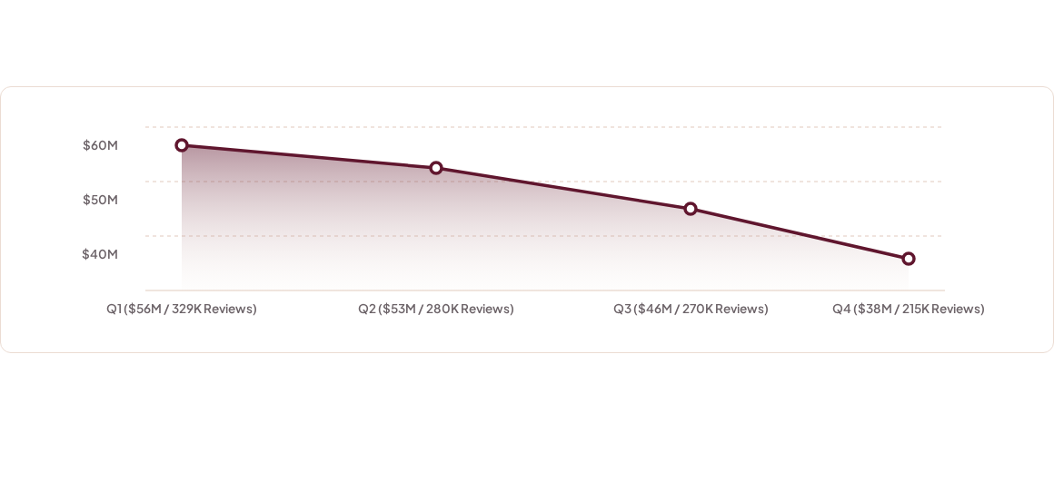
Quarterly Demand Seasonality
Demand Analysis: Q1 represents the primary skincare demand surge ($56M proxy) driven by post-holiday routine resets, requiring procurement schedules to align inventory build in late Q4.

Slide 9

Strategic Decision Matrix
Strategic Pillar | Target Commercial Decision | Measurable Business Impact
Quality Remediation | Audit formulations and product page descriptions on 44 Attention SKUs. | Ring-fences $6.27M in revenue proxy and reduces customer returns.
Procurement Freeze | Enforce immediate purchase order holds on 5 out-of-stock low-rated items. | Prevents replenishing inventory with confirmed formula/packaging defects.
Assortment Scaling | Expand vendor onboarding in the $50–$100 Tier and scale limited drops. | Captures higher unit gross margin backed by $57.18 price elasticity.
Supply Chain Timing | Front-load inventory buffer and warehouse capacity for peak Q1 demand. | Captures 329K review demand surge and eliminates seasonal stockouts.

Slide 10
Financial ROI & Value Creation
$6.27M Protected: Eliminating failing formulations protects recurring revenue, prevents customer churn, and lowers return processing costs.
+4.2% Margin Expansion: Scaling Limited Edition items leverages proven pricing power ($57.18 vs. $55.58) to lift seasonal basket profitability.
$78M Sweet Spot Yield: Focusing new brand partnerships on the $50–$100 price tier aligns catalog curation with peak consumer willingness-to-pay.
Zero Stockout Slippage: Aligning supply chain lead times ahead of Q1 demand captures an estimated $8M+ in unfulfilled post-holiday demand.

Slide 11




90-Day Operational Roadmap
Days 76–90
Days 16–45
Rebalance Q4/Q1 inventory purchasing models to eliminate stockouts during the peak demand surge.
Conduct root-cause formula and PDP audits across the 44 low-rated items scoring under 3.50★.
Days 1–15
Days 46–75
Enforce immediate procurement holds on 5 out-of-stock Attention SKUs and notify vendor managers.
Restructure seasonal drops and scale SKU onboarding in the high-yield $50–$100 Premium Tier.

Slide 12
Questions & Discussion
Thank you for your time. All SQL scripts, data validation models, and Power BI dashboards are fully documented and production-ready.

